Slide 1
Drivers of Natural Gas Prices In The United States
Group Members:
Wilson Aliaga
Carlton Lewis
Velmarini Vasquez

Slide 2
Project Questions
Supply Drivers questions
How does production vary over time in different regions of the country, especially in the counties with natural gas reserves?
How does the Storage changes over time based on the facilities (e.g. Pipelines) available in the counties or regions with natural gas reserves?
How does Imported gas contribute to the supply overtime?
Demand questions
How does temperature changes affect gas demand?
How does economic growth influence gas consumption?

Slide 3
Data Set Sources
U.S. Energy Information Administration (EIA)
World Weather
Federal Reserve Economic Data (FRED)
US Census Database

Slide 4
DatA ExploratioN
Data
Sources | Extraction | Cleaning | Type | Quantity | Analysis Methods
EIA | API Key JSON Excel Files | Conversion into, into pandas dataframes lists or dictionaries for data manipulation. Excel files conversion into pandas dataframes | Natural gas : Production Consumption Storage Prices | 7262 series 20 Excel spreadsheets conversion into pandas data frame for data manipulation. | Descriptive statistics Time series Regression Analysis Matrix analysis
World Weather | API Key | Conversion into dictionary for data manipulation | Historical temperature changes | 1 series | Time series
Google Maps Platform | API Key | Conversion into, into pandas dataframes lists or dictionaries for data manipulation. | USA Map | JSON file to explore 3221 counties delimitations | Production changes per county over time.
FRED | CSV file | Conversion into Pandas dataframe | CPI extraction | 1 CSV | Conversion of US $ to 2018 value
Census | API Key | Conversion into pandas dataframe | Testing Map | 1 series | Superposed on Google map to determine county per state

Slide 5
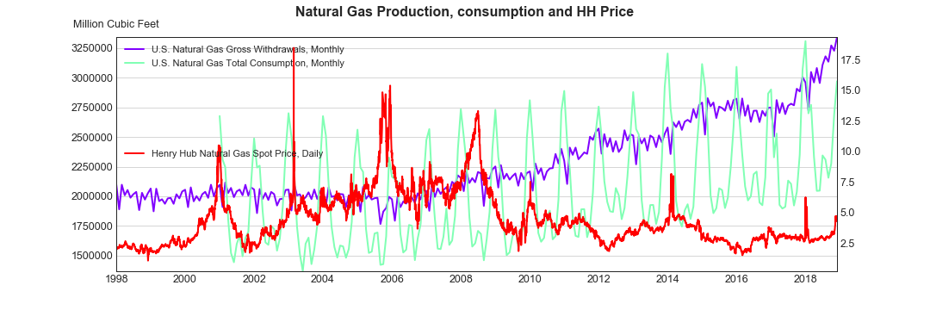
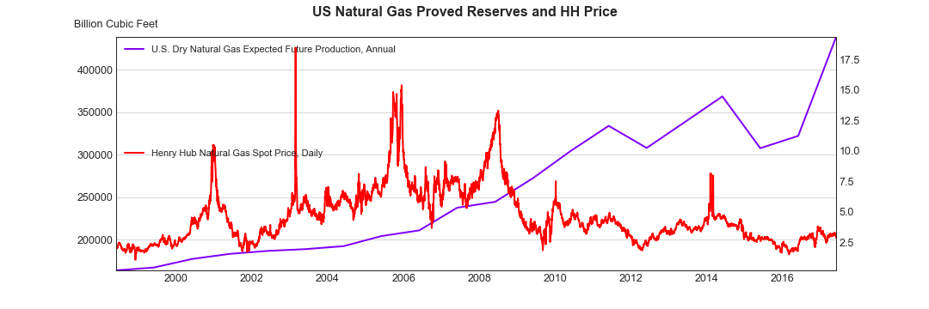

Slide 6
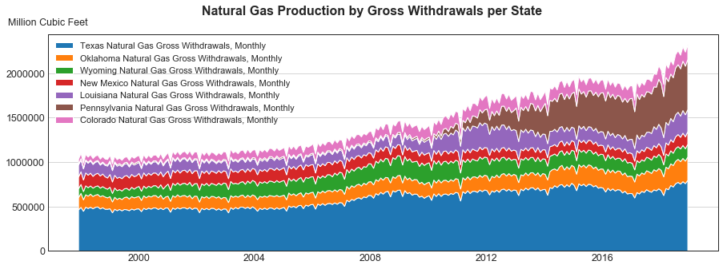
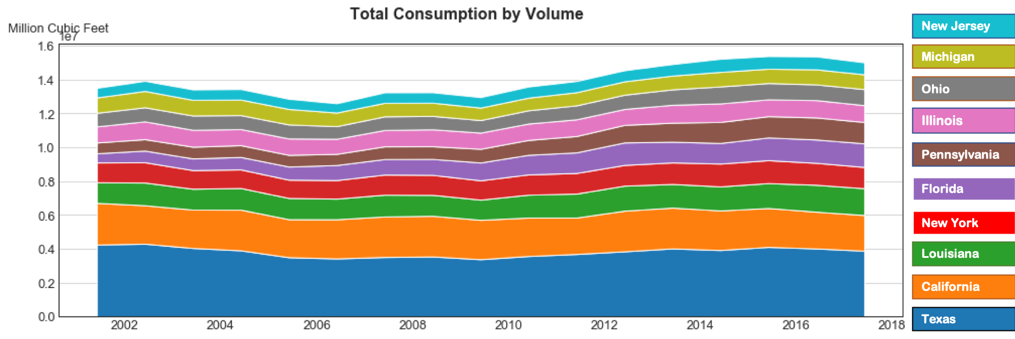

Slide 7
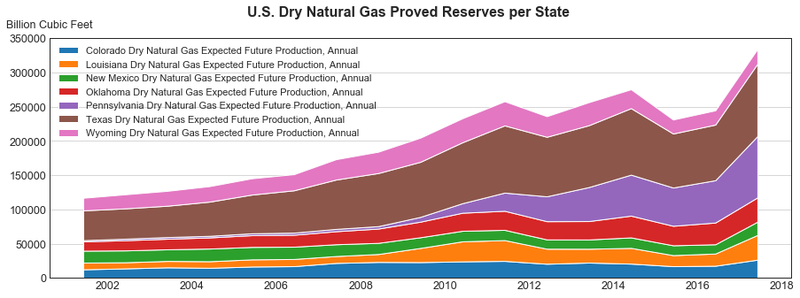

Slide 8
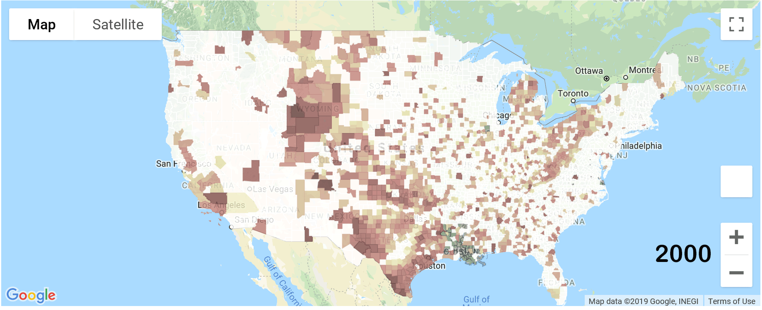
U.S. GaS Production

Slide 9
Analysis Process

Slide 10
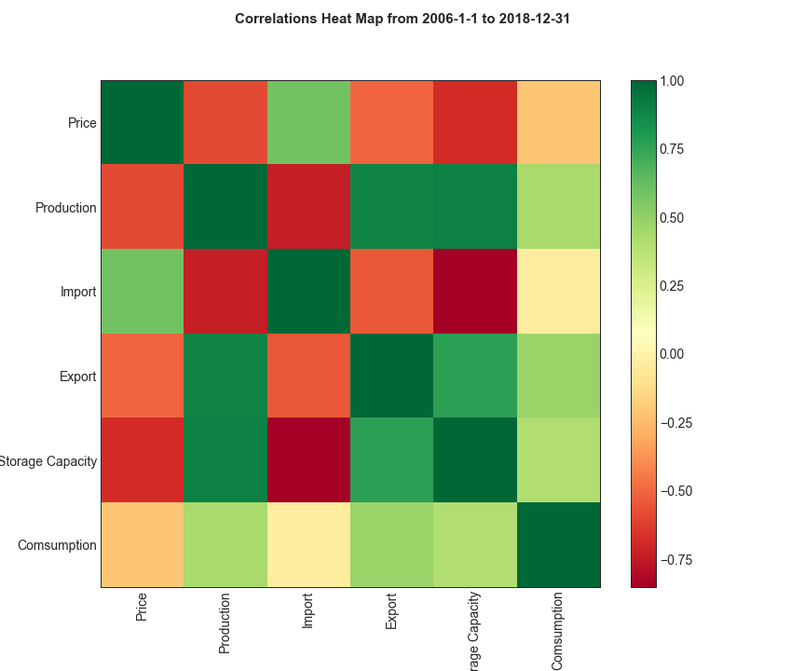

Slide 11
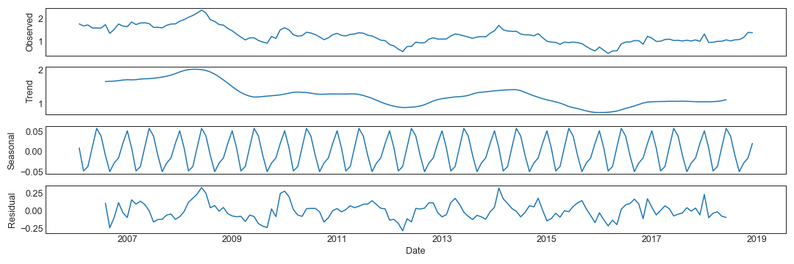

Slide 12
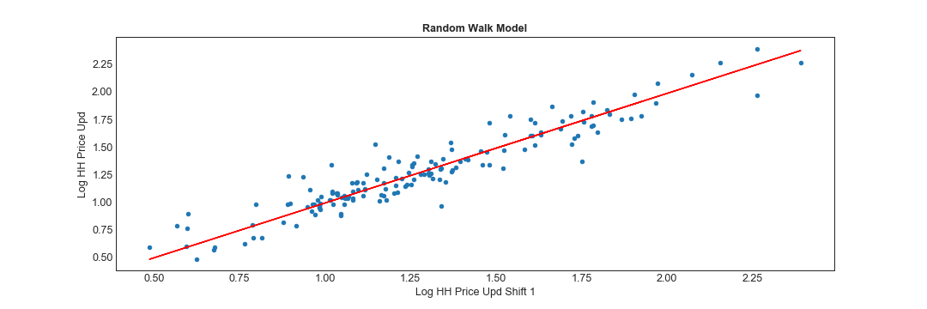
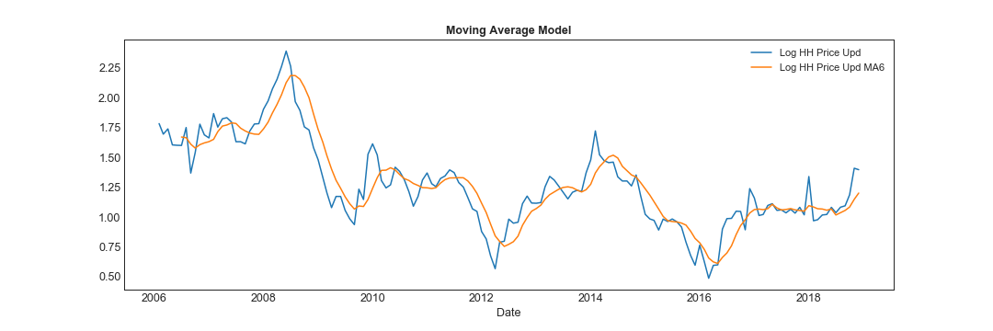

Slide 13
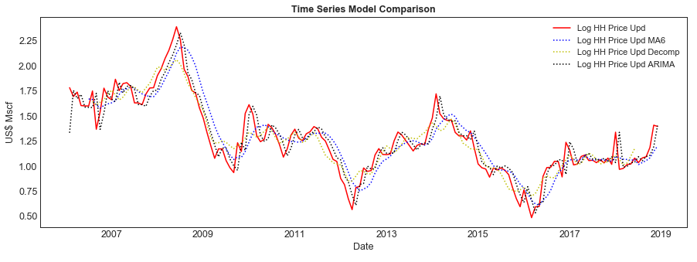

Slide 14
conclusions
This should include a numerical summary as well as visualizations of that summary.

Slide 15
implications of the findings
This is where you get to have an open-ended discussion about what your findings "mean".

